Slide 1
A tutorial on
Principal Components Analysis
Lindsay I Smith
Presenter: Tsung-Jung Tsai (蔡宗容)
Date: Sept. 17, 2008

Slide 2
PCA
PCA is a useful statistical technique that has found application in fields such as
(1) face recognition,
(2) image compression,
(3) and is a common technique for finding patterns in data of high dimension.

Slide 3
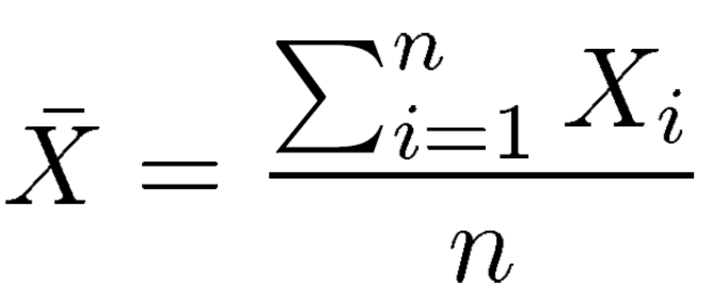
Average
X = [1 2 4 6 12 15 25 45 68 67 65 98]
X₁ = 1
X₃ = 4

Slide 4
Standard deviation (1/3)
Unfortunately, the mean doesn’t tell us a lot about the data except for a sort of middle point.
X = [0 8 12 20], the mean of X is 10.
Y = [8 9 11 12], the mean of Y is 10.
Z = [10 10 10 10], the mean of Z is 10.

Slide 5
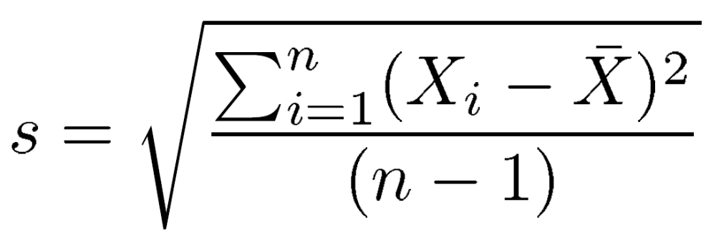
Standard deviation (2/3)
So what is different about these two sets?
It is the spread of the data that is different.

Slide 6
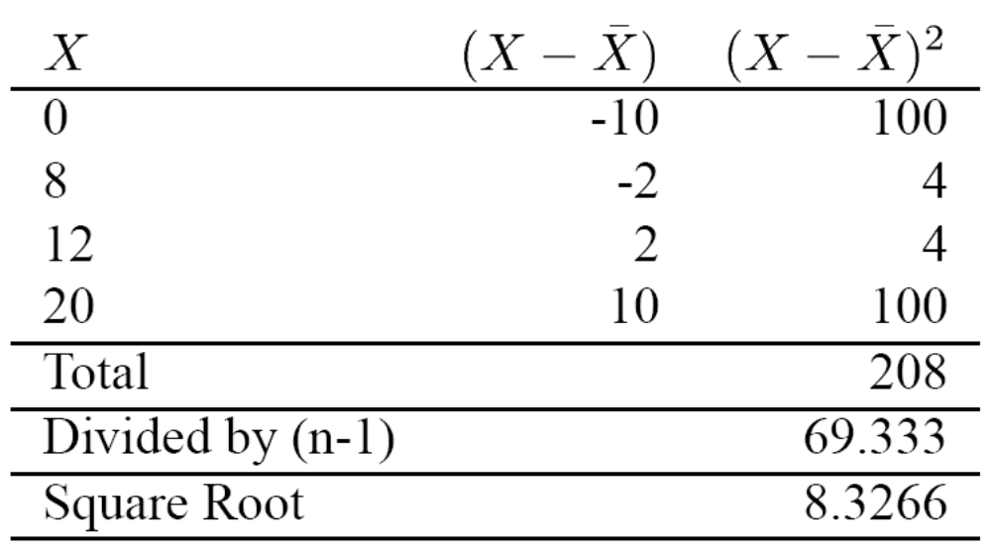
X = [0 8 12 20], the mean of X is 10

Slide 7
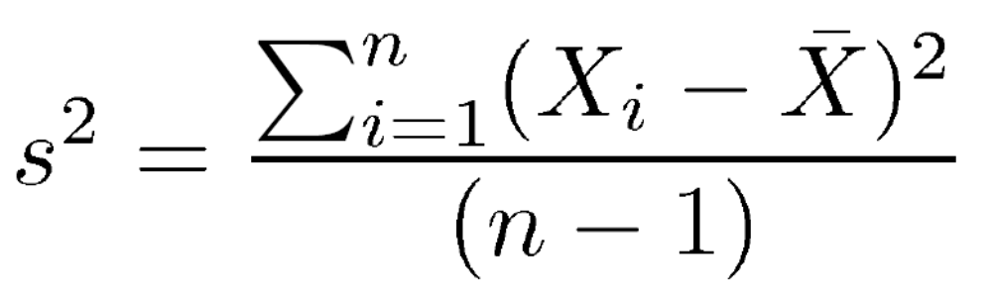
Variance
Variance is another measure of the spread of data in a dataset.

Slide 8
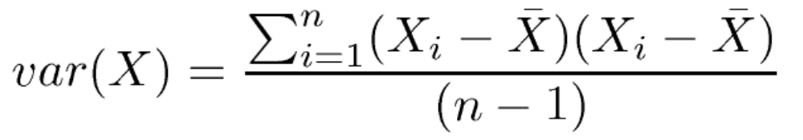
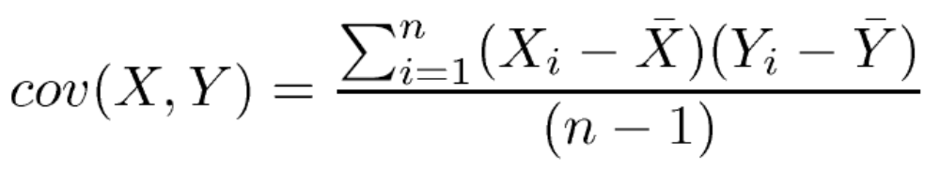
Covariance (1/5)
Covariance is to find out how much the dimensions vary from the mean with respect to each other.

Slide 9
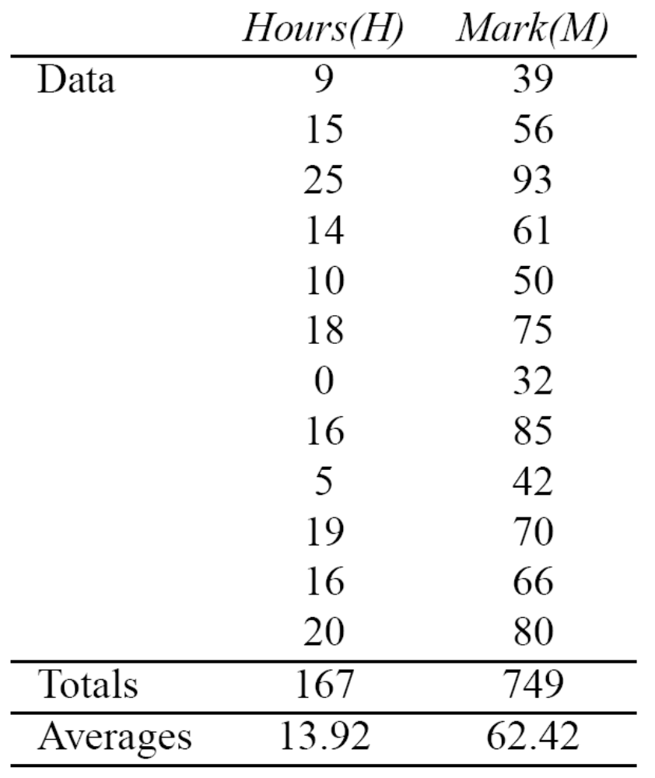
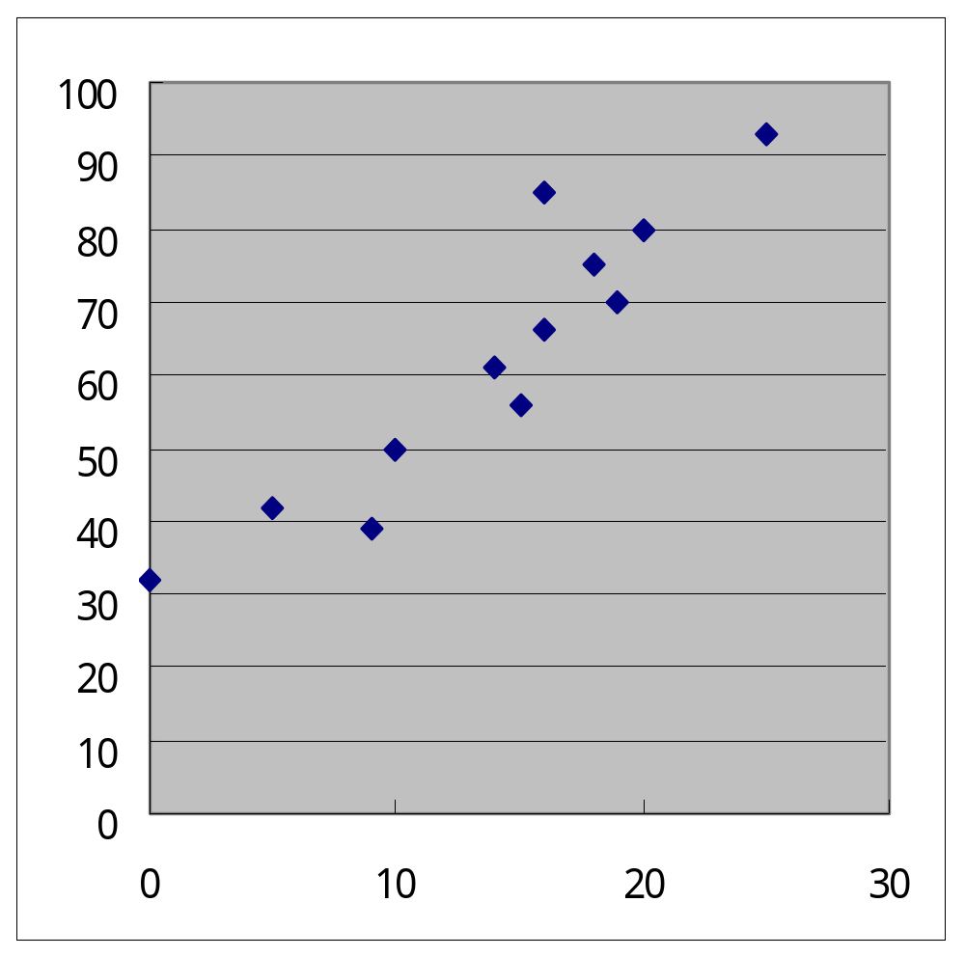

Slide 10
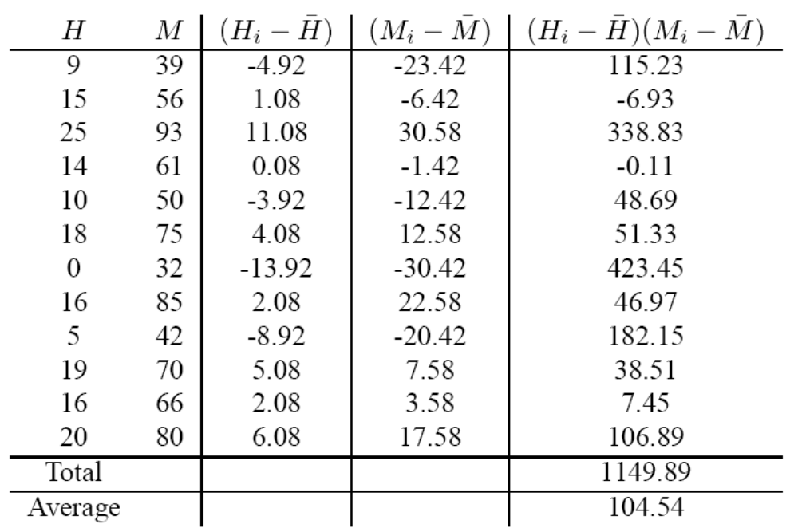

Slide 11
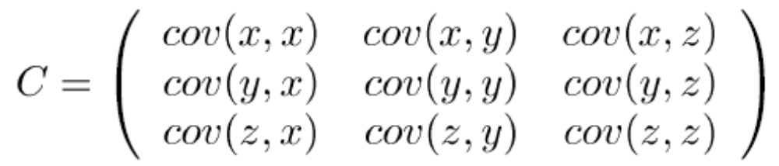
Covariance (4/5)
Covariance is always measures between 2-dimensions.
If you had a 3-dimensional data set (x, y, z),
then you could measure the covariance between the x and y dimensions, the x and z dimensions, and the y and z dimensions.

Slide 12
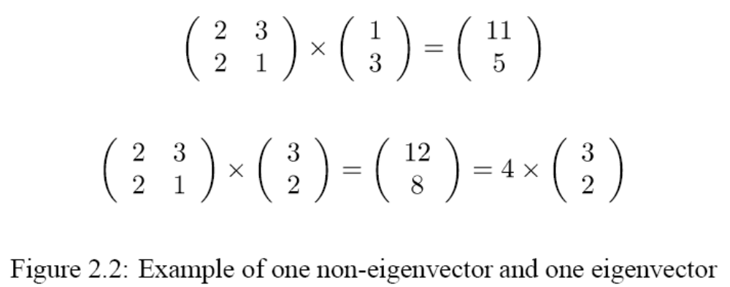
Non-eigenvector and eigenvector

Slide 13
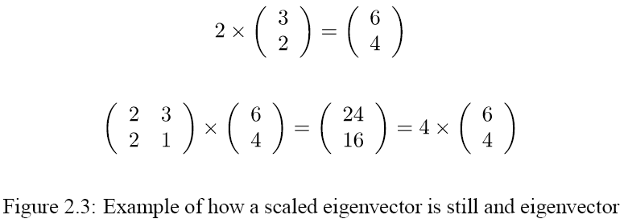
A scaled eigenvector

